Slide 1


Siebwalde Application
Siebwalde Track Control
Fiddle Yard Control
Yard Control
City Control
_ □ X
Siebwalde Application

Slide 2

Siebwalde Application
Siebwalde Track Control
Fiddle Yard Control
Yard Control
City Control
_ □ X
Settings

Slide 3

Siebwalde Application
Siebwalde Track Control
Fiddle Yard Control
Yard Control
City Control
_ □ X
Start All Controllers
Siebwalde Application started.
Main: PC MAC adress is: 305A3A49DACD
Main: PC IP adress is: 169.254.208.33
Main: FiddleYard Controller starting...
FYCTRL: Pinging FIDDLEYARD target...
FYCTRL: No such host is known
FYCTRL: Fiddle Yard uController target in simulator mode
FYCTRL: Fiddle Yard uController Reset.
Main: FiddleYard Controller started.
MTCTRL: Pinging Track controller target...
MTCTRL: Ping successfull.
MTCTRL: Track uController target in real mode.
MTCTRL: Track controller Connecting...
MTCTRL: Track controller Connected.
Main: Track Controller started.
Start Track Controller
Start Fiddle Yard Controller
Start marshalling yard Controller
Start City Controller
Logging

Slide 4
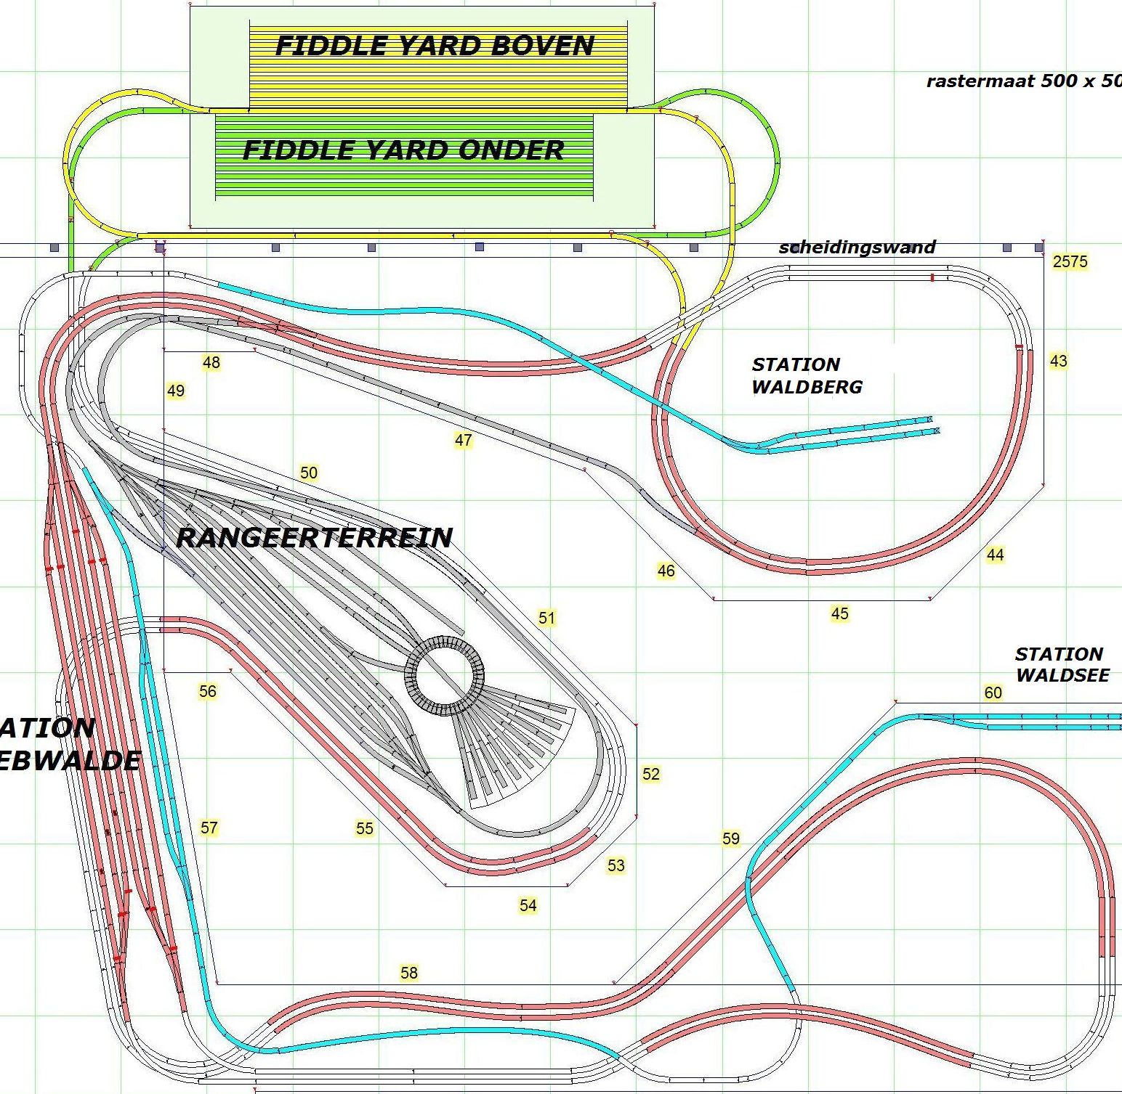


Siebwalde Application
Siebwalde Track Control
Fiddle Yard Control
Yard Control
City Control
_ □ X
Start Automatic Track Operation

Slide 5
Siebwalde Application
Siebwalde Track Control
Fiddle Yard Control
Yard Control
City Control
_ □ X
ETH
MBUS
1 | 2 | 3 | 4 | 5 | 6 | 7 | 8 | 9 | 10 | 51
11 | 12 | 13 | 14 | 15 | 16 | 17 | 18 | 19 | 20 | 52
21 | 22 | 23 | 24 | 25 | 26 | 27 | 28 | 29 | 30 | 53
31 | 32 | 33 | 34 | 35 | 36 | 37 | 38 | 39 | 40 | 54
41 | 42 | 43 | 44 | 45 | 46 | 47 | 48 | 49 | 50 | 55
Ethernet – Modbus Controller
Track Amplifiers

Slide 6
Siebwalde Application
Siebwalde Track Control
Fiddle Yard Control
Yard Control
City Control
_ □ X
Settings

Slide 7
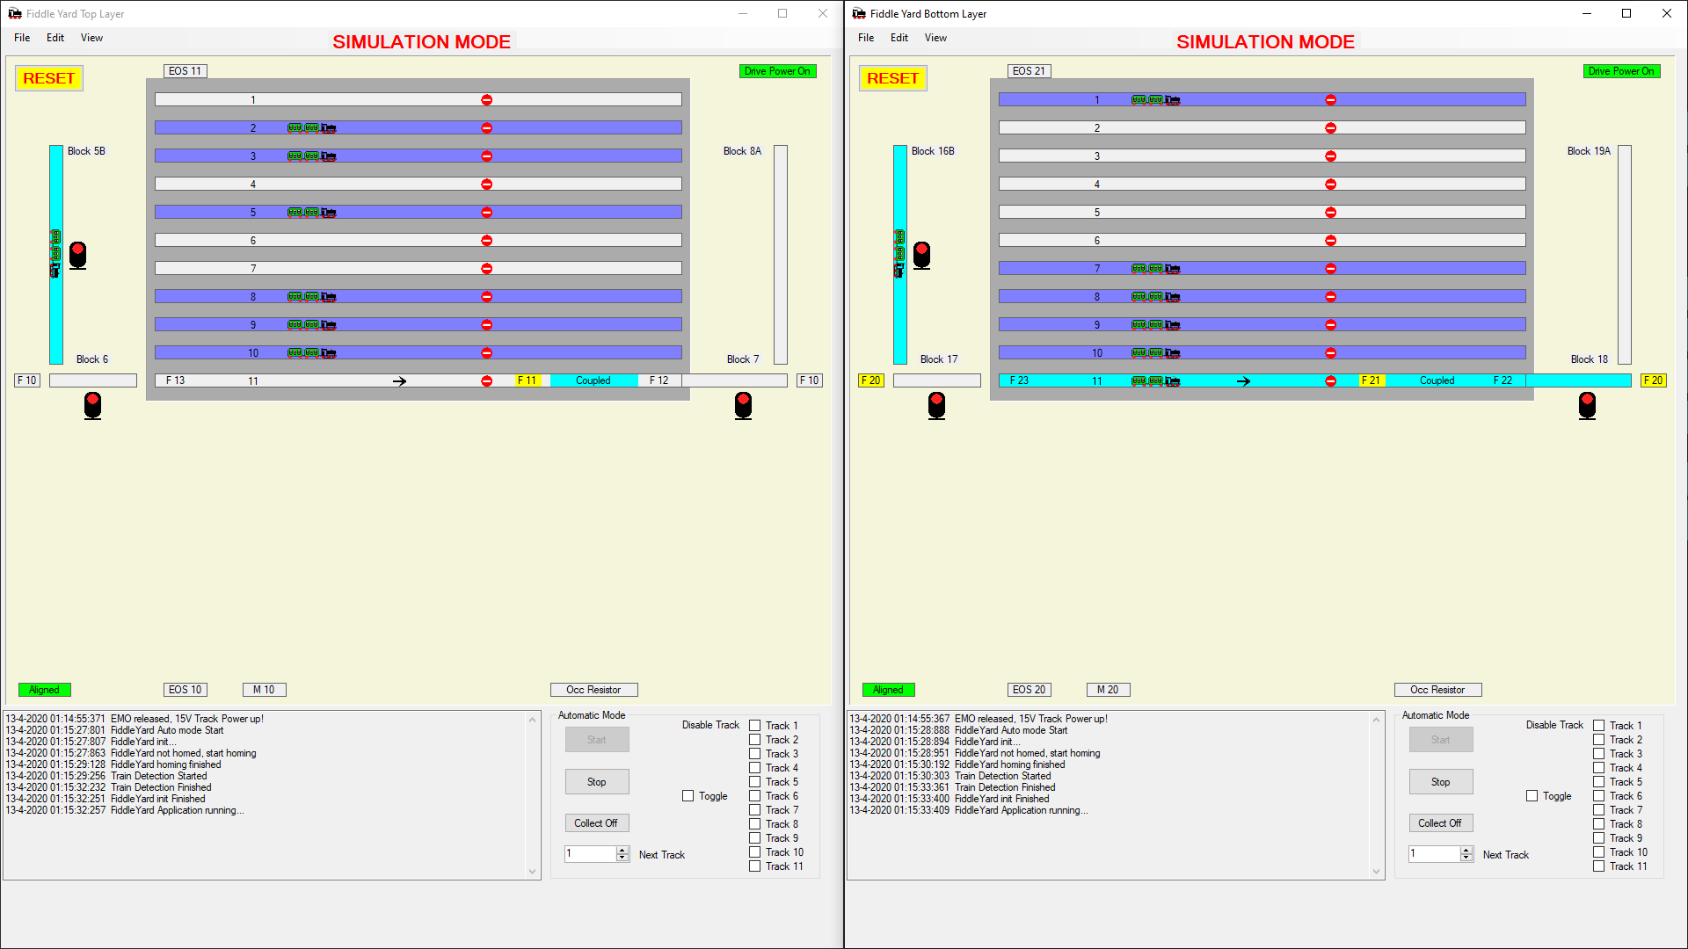
Siebwalde Application
Siebwalde Track Control
Fiddle Yard Control
Yard Control
City Control
_ □ X

Slide 8
Siebwalde Application
Siebwalde Track Control
Fiddle Yard Control
Yard Control
City Control
_ □ X

Slide 9
Siebwalde Application
Siebwalde Track Control
Fiddle Yard Control
Yard Control
City Control
_ □ X

